Slide 1
Site to Cloud(S2C) VPN API
China Telecom, Huawei
Contacts: xudan6@chinatelecom.cn, qingshuting1@huawei.com

Slide 2
Contents
Background
S2C VPN solution
S2C VPN API
User story
S2C VPN API Deliverables Plan

Slide 3
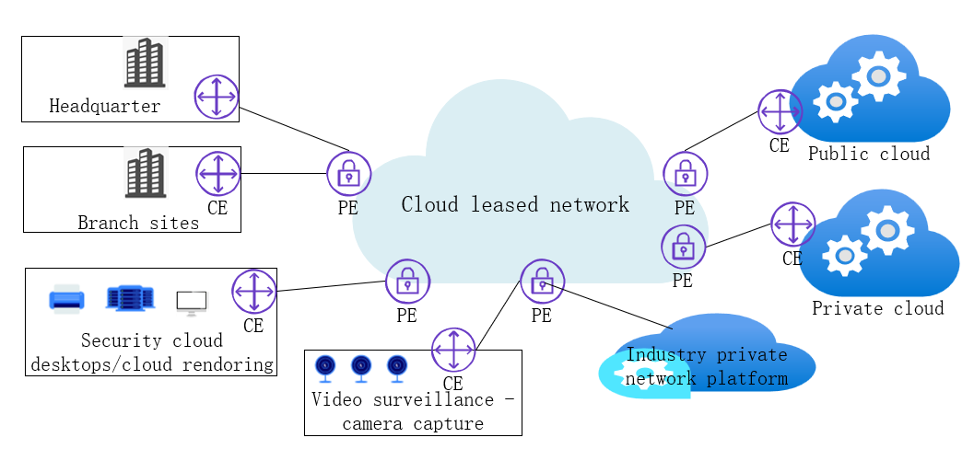
1. Background- what drives S2C VPN API
Elastic large bandwidth
Flexible on-demand access modes
Private, non public, better than Internet access(Low latency, high guarantee,security)
S2C VPN requirements
Easy use/invocation
Fast service provisioning
Flexibly expanded conection of customers’ branch sites
API benefit
New business scenarios driven：
The demand for cloud leased networks for new business scenarios is exploding. Traditional standardized product delivery models are difficult to meet real-time, dynamic, and on-demand service needs.
S2C VPN API invocation will become the mainstream, driving agile provision of cloud connectivity network services.

Slide 4






2. S2C VPN API
Operator Portal
Aggregator Portal
Service API
S2C VPN API: Creation/Modification/Query/Deletion of leased line
Exposure Gateway
Transformation Function
Network API
MAN Controller
Backbone Controller
Cloud Controller
Public Cloud
MAN
Backbone
Public Cloud
Private Cloud

Slide 5
3. S2C VPN API
Overview
Instead of ordering a private or customized network service by phone call, or through customer manager manually, this S2C VPN API allows users to create and configure site to cloud network service according to the user request by one click. With the proposed API, when someone calls the API service with network SLA requirements , telecom operators can create non-public cloud leased network service by orchestrating the IP VPN connections of metropolitan network and/or backbone network.
S2C VPN API aims to provide multi-site, multi-cloud network connection for customers, and provide virtual private network services for industries and applications such as education, medical, Internet of things, cloud desktop, cloud conference, cloud recording and etc.

Slide 6
3. S2C VPN API family
API name | API function | Method
S2C VPN booking | For customer's service booking with specific access node and SLA requirements , check the network availability level, and corresponding fees | Post
S2C VPN creation | Create S2C VPN service, providing: network availability level( A-low, AA-medium，AAA-high) bandwidth, duration | Post
S2C VPN modification | Modify/ adjust S2C VPN service bandwidth | Post
S2C VPN query | Query S2C VPN service information: S2C VPN service real-time QoS S2C VPN service order information S2C VPN service guarantee log | Get
S2C VPN deletion | Delete S2C VPN service information | Delete

Slide 7
3.S2C VPN API
Enterprise Customer
Modification/Query/Deletion request
Modification/Query/Deletion response
S2C VPN booing request（ SLA，start node-end node）
S2C VPN booing response（network availability level, fees assessment ）
S2C VPN creation request
S2C VPN creation response
Operator
The operator calculates the access resources availability and fees for different availability levels that meet the SLA
The operator agrees to create S2C VPN service that meet SLAs
Service Agreement consent
The operator configures the network level resource
Configuration complete
API operation and management
Network Controllers(Configure VLAN, L3VPN,...)
Cloud Controllers(VLAN/VXLAN,...)
Network resource layer
CT infrastructure
Cloud infrastructure

Slide 8
4.user story
item | Details
Summary | As an application developer or industry customer, I want to request (using my application server/backend service)cloud leased network connection service between siteA/cloudA and siteB/cloudB from a Communication Service Provider (CSP), so that I can ensure better and more reliable quality for our end users at any required time with proper cost.
Roles, Actors and Scope | Roles: Customer:User Actors: Application service providers, industry customer, application developers. Scope: Service Booking(check network availability level, and corresponding fees ) - Create/Remove/Modify/Query service instance (S2C VPN session resource)
Activities/Steps | Starts when: The customer application server makes a POST request(including required service area(access node and end node ), bandwidth requirements,etc) to the S2C VPN service provision creation API to create a new S2C VPN session resource. Ends when: The customer application server makes a DELETE request to the S2C VPN service deletion API , or the S2C VPN service deletion session resource deletion was triggered automatically either because the customer specified duration has expired or the default expiration limit set by the S2C VPN service provider has reached.

Slide 9
5. S2C VPN API Deliverables Plan
Deliverable Required/Optional (R/O) Current status
API Specs | R | TBD(code)
API documentation | R | In progress
User stories | R | In progress
Test cases | R | TBD
Implementation | O | TBD

